Slide 1

RESEARCH PRESENTATION | SAN DIEGO COUNTY
Strategic Location and
Survival Dynamics of Businesses
A Comparative Machine Learning and Geospatial Approach
Kenier Ramirez, M.Sc. in Data Analytics
Applied Machine Learning and Geospatial Data Analytics

Slide 2
Study at a glance
EXECUTIVE SUMMARY
158,330 initial records
140,737 establishments
137,814 observations
Integrated public-data corpus
Final cleaned analytical dataset
Supervised modeling matrix after coordinate exclusions
Best overall classifier
Main model insight
Interpretation boundary
LightGBM
Accuracy 0.835679 | F1 0.792553
ROC-AUC 0.911295
Business age was the strongest SHAP contributor, followed by ownership indicators.
The target is recorded Active vs. Closed/Cancelled status—not time-to-event survival.
Bottom line: ensemble classifiers outperformed the Logistic Regression baseline on the same holdout test set.
STRATEGIC LOCATION & RECORDED BUSINESS STATUS | SAN DIEGO COUNTY
2

Slide 3
What the model does—and does not—estimate
RESEARCH SCOPE
Outcome modeled
Not estimated in this study
CLASS 1 • Active
CLASS 0 • Closed / Cancelled
The study classifies the status recorded in the business registry using establishment, ownership, industry, and geographic features.
No time-to-closure estimate
No hazard rate
No median survival time
No probability of remaining open for a specified future period
A formal time-to-event study is proposed as future research.
Throughout this presentation, “business survival” is used only as the study’s broader topic; reported model outputs are business-status classifications.
STRATEGIC LOCATION & RECORDED BUSINESS STATUS | SAN DIEGO COUNTY
3

Slide 4
Research question and benchmark
RESEARCH DESIGN
Can predictive machine-learning models classify recorded business status and identify structural and geographic characteristics associated with that status?
Prespecified baseline criterion
How to interpret the test
Logistic Regression F1-score benchmark: 0.70
H₀: F1 < 0.70
H₁: F1 ≥ 0.70
This is a benchmark-based performance criterion—not a conventional hypothesis test about a population parameter. Ensemble comparisons are descriptive.
STRATEGIC LOCATION & RECORDED BUSINESS STATUS | SAN DIEGO COUNTY
4

Slide 5
Data sources and analytical scope
DATA & PIPELINE
Business registry
Demographic baseline
Geospatial boundaries
City of San Diego Active and Inactive Business Listings
Records reported for 1926–2025
SANDAG 2020 Census population by ZIP code
U.S. Census TIGER/Line county boundary and ZIP Code Tabulation Areas
Scope and feature engineering
• 45 canonical San Diego County municipalities; 18 primary economic sectors.
• NAICS 92 (Public Administration) and NAICS 22 (Utilities) excluded.
• Business density defined as active businesses per 1,000 residents within a ZIP-code area, using the 2020 population baseline.
• Business-age bands: [0,1), [1,3), [3,5), [5,10), [10,20), and [20,∞) years.
STRATEGIC LOCATION & RECORDED BUSINESS STATUS | SAN DIEGO COUNTY
5

Slide 6
From source records to model evaluation
DATA & PIPELINE
158,330
Initial integrated corpus
140,737
Final cleaned analytical dataset
137,814
Supervised matrix after excluding 2,923 records without valid coordinates
The 140,737-record cleaned corpus and 137,814-observation supervised matrix are distinct stages and should not be conflated.
STRATEGIC LOCATION & RECORDED BUSINESS STATUS | SAN DIEGO COUNTY
6

Slide 7
Train/test design and class balancing
MODEL DEVELOPMENT
Training partition
SMOTE training only
Holdout test partition
110,251 records
69,998 closed (class 0)
40,253 active (class 1)
Balanced to 69,998 per class
139,996 training observations
27,563 records
Not oversampled
Stratified 80/20 split
137,814
observations
110,251
training
27,563
test
The holdout test data remain unaltered to provide a consistent evaluation set for all five classifiers.
STRATEGIC LOCATION & RECORDED BUSINESS STATUS | SAN DIEGO COUNTY
7

Slide 8
Predictors and modeling workflow
MODEL DEVELOPMENT
Predictor set
Modeling workflow
Business age
Population
Latitude and longitude
Business density
Ownership type
Standardized NAICS sector
City
Numeric features standardized
Categorical features one-hot encoded
Stratified train/test partition
SMOTE applied only to training data
Five classifiers evaluated on the same holdout test set
Classifiers: Logistic Regression • Random Forest • Gradient Boosting • XGBoost • LightGBM
STRATEGIC LOCATION & RECORDED BUSINESS STATUS | SAN DIEGO COUNTY
8

Slide 9
Categorical associations with recorded closure status
STATISTICAL RESULTS
Bivariate relationship | χ² statistic | p-value
Status × business-age group | 43,982.345 | < .001
Status × ownership type | 9,750.728 | < .001
Status × NAICS sector | 2,564.842 | < .001
Status × city | 1,106.014 | < .001
Status × ZIP code | 2,617.481 | < .001
Ownership type × NAICS sector | 23,824.131 | < .001
All six tests reject independence at p < .001. Large samples can make weak associations statistically significant; effect sizes should be reported where available.
STRATEGIC LOCATION & RECORDED BUSINESS STATUS | SAN DIEGO COUNTY
9

Slide 10
Business age varies across industry and ownership groups
STATISTICAL RESULTS
Across NAICS sectors
Across ownership types
Kruskal–Wallis H = 5,068.22
p < .001
At least one sector’s business-age distribution differs.
Kruskal–Wallis H = 6,349.01
p < .001
Levene statistic = 1,167.70; p < .001
Interpretation
• Kruskal–Wallis compares distributions/ranks; it is not a direct test of group means.
• Omnibus significance does not mean every pair of groups differs.
• The exact post-hoc procedure and multiplicity adjustment should be named only after verification from the analysis code.
STRATEGIC LOCATION & RECORDED BUSINESS STATUS | SAN DIEGO COUNTY
10

Slide 11
Population is positively associated with active-business counts
STATISTICAL RESULTS
Spearman correlation
Log–log relationship
Measure clarified
ρ = 0.6526
p = 3.48 × 10⁻¹⁴
Fitted slope = 1.319
Positive, superlinear pattern
Active-business COUNT
—not rate per 1,000 residents
ZIP codes with larger populations tended to have proportionally greater active-business counts. This is an observed association; it does not show that population causes business activity.
This finding concerns active-business counts; it should not be interpreted as a correlation with the active-business rate per 1,000 residents.
STRATEGIC LOCATION & RECORDED BUSINESS STATUS | SAN DIEGO COUNTY
11

Slide 12
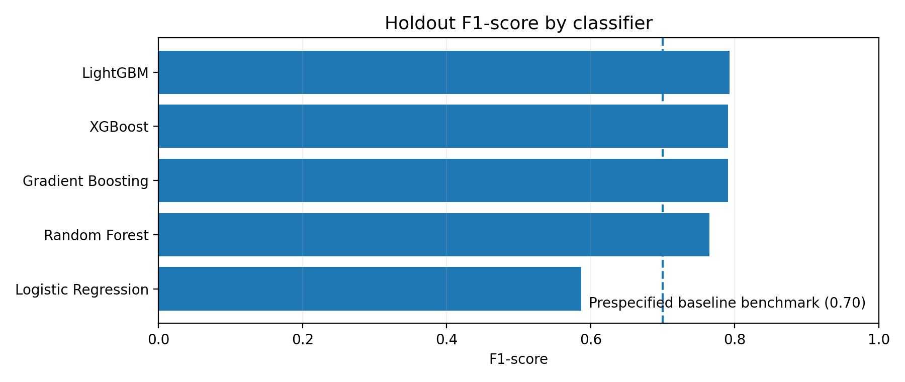
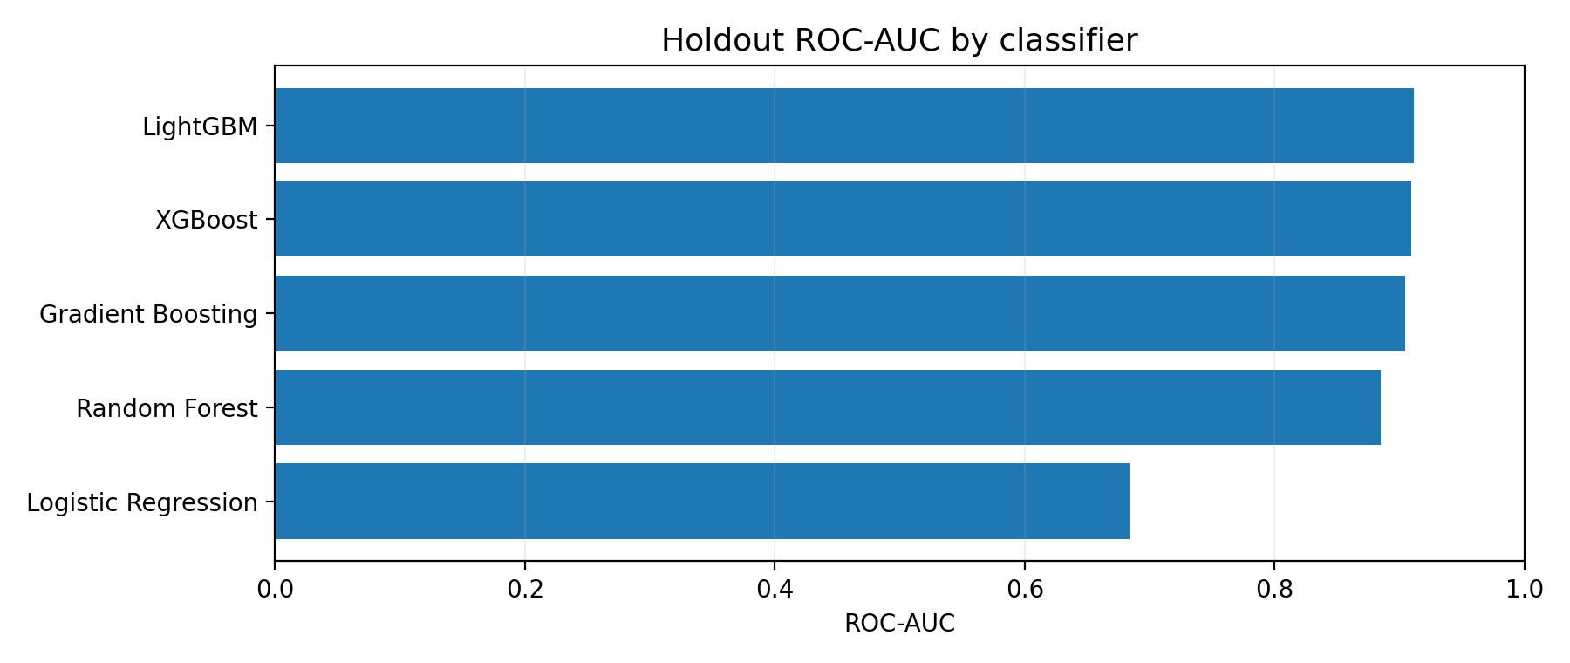
Comparative model performance on the holdout set
MODEL RESULTS
LightGBM leads on F1 and ROC-AUC; XGBoost has the highest precision (0.829190).
STRATEGIC LOCATION & RECORDED BUSINESS STATUS | SAN DIEGO COUNTY
12

Slide 13
Full holdout metrics
MODEL RESULTS
Model | Accuracy | Precision | Recall | F1-score | ROC-AUC
LightGBM | 0.835679 | 0.827757 | 0.760220 | 0.792553 | 0.911295
XGBoost | 0.834613 | 0.829190 | 0.754970 | 0.790341 | 0.908955
Gradient Boosting | 0.834506 | 0.827840 | 0.756519 | 0.790574 | 0.904714
Random Forest | 0.811549 | 0.789672 | 0.740942 | 0.764531 | 0.884499
Logistic Regression | 0.661834 | 0.592019 | 0.582236 | 0.587087 | 0.683970
LightGBM: highest accuracy, recall, F1-score, and ROC-AUC. XGBoost: highest precision.
Differences among the leading ensemble models are descriptive; no paired significance test is reported.
STRATEGIC LOCATION & RECORDED BUSINESS STATUS | SAN DIEGO COUNTY
13

Slide 14
Logistic Regression did not meet the prespecified benchmark
MODEL RESULTS
Observed F1-score
0.587087
Benchmark
0.70
The baseline fell below the criterion. This is a benchmark comparison, not a population-parameter significance test.
STRATEGIC LOCATION & RECORDED BUSINESS STATUS | SAN DIEGO COUNTY
14

Slide 15
What contributes to LightGBM predictions?
MODEL INTERPRETATION
1 Business age
2 Ownership indicators
3 Contextual features
Strongest contributor to model predictions. Higher age generally pushed predictions toward Active status.
Among the next most influential features; effects describe model behavior, not causal impact.
Selected density, geographic, and industry features added information; their SHAP distributions were narrower.
SHAP explains contributions to the fitted LightGBM model output.
It does not establish that business age or legal form causes closure, does not measure independent statistical significance, and does not produce a time-to-event survival probability.
STRATEGIC LOCATION & RECORDED BUSINESS STATUS | SAN DIEGO COUNTY
15

Slide 16
K-Prototypes: four descriptive business profiles
CLUSTERING
Cluster | Business age (standardized) | Population | Density | Prominent profile
0 | Older (+2.42) | Slightly below average (−0.16) | Slightly below average (−0.12) | Professional/scientific/technical; sole
1 | Younger (−0.28) | Below average (−0.42) | Near average (−0.04) | Professional/scientific/technical; sole
2 | +0.27 | Low (−2.24) | High (+5.52) | Professional/scientific/technical; corporate
3 | Younger (−0.28) | Higher (+1.24) | Lower (−0.41) | Retail; sole
K-Prototypes combined numeric features (age, population, density) with categorical features (NAICS sector and ownership). The k = 4 solution is descriptive; clusters are not validated business types or causal risk classes.
STRATEGIC LOCATION & RECORDED BUSINESS STATUS | SAN DIEGO COUNTY
16

Slide 17
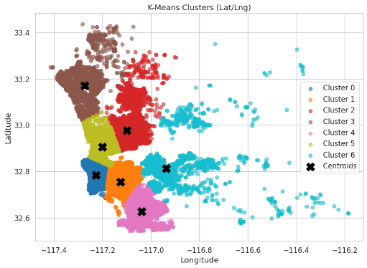
Spatial K-Means: seven coordinate-based clusters
CLUSTERING
Cluster | Count | Mean age | Density
0 | 23,754 | 9.70 | 114.86
1 | 55,919 | 8.80 | 119.41
2 | 17,362 | 9.30 | 61.91
3 | 2,454 | 8.39 | 5.36
4 | 15,850 | 7.74 | 52.18
5 | 17,391 | 9.76 | 227.83
6 | 5,084 | 8.66 | 22.60
The seven cluster counts sum to 137,814. Centroids are approximate; K-Means does not enforce administrative boundaries or road-network constraints.
STRATEGIC LOCATION & RECORDED BUSINESS STATUS | SAN DIEGO COUNTY
17

Slide 18
Integrated interpretation
DISCUSSION
Predictive performance
Business structure
Geographic context
Nonlinear ensembles achieved higher holdout scores than the Logistic Regression baseline.
Age and ownership indicators contributed strongly to LightGBM predictions.
Industry, population, density, and spatial segmentation add context but do not establish causal location effects.
What the evidence supports
• Use model results as exploratory decision support, not as a guarantee of future business outcomes.
• Interpret clusters as descriptive summaries of registry patterns.
• Validate prospectively and externally before applying the model to other time periods, counties, or registry systems.
STRATEGIC LOCATION & RECORDED BUSINESS STATUS | SAN DIEGO COUNTY
18

Slide 19
Potential applications—subject to validation
PRACTICAL IMPLICATIONS
Business support research
Sector-informed planning
Evaluate whether mentoring, financial-management resources, or technical assistance are useful for businesses at different recorded age stages.
Use sector and cluster patterns to generate hypotheses for local needs assessments—not to assume that a sector or area is inherently high risk.
Site assessment
Model governance
Combine registry patterns with additional market, zoning, transportation, and current demographic evidence before making location decisions.
Monitor data quality, class balance, calibration, threshold choice, and performance drift before operational use.
The study does not demonstrate that a specific intervention improves survival or that any location optimizes business outcomes.
STRATEGIC LOCATION & RECORDED BUSINESS STATUS | SAN DIEGO COUNTY
19

Slide 20
Limitations and next research steps
LIMITATIONS & FUTURE WORK
Current study limitations
Future formal survival analysis
Registry may omit informal or unregistered businesses.
Population baseline is from 2020.
2,923 records without valid coordinates were excluded from supervised modeling.
One holdout partition; external and temporal validation remain necessary.
Observational associations and SHAP contributions are not causal.
Obtain establishment-level opening dates, verified closure dates, censoring dates, and repeated status observations.
Define time origin, event, censoring, and active-business follow-up.
Then consider Kaplan–Meier curves, log-rank tests, and Cox or parametric survival models.
A time-to-event model is a proposed extension—not an analysis performed in this study.
STRATEGIC LOCATION & RECORDED BUSINESS STATUS | SAN DIEGO COUNTY
20

Slide 21
Conclusion
TAKEAWAYS
The ensemble classifiers provided stronger holdout classification performance than the Logistic Regression baseline.
Best overall
Most influential
Important boundary
LightGBM
F1 = 0.792553
ROC-AUC = 0.911295
Business age, followed by ownership indicators, in the SHAP interpretation.
Recorded status classification—not time-to-event survival or causal inference.
Research repository
github.com/Kenier91/Business-Survival-Site-Selection-Analytics-for-San-Diego-County
STRATEGIC LOCATION & RECORDED BUSINESS STATUS | SAN DIEGO COUNTY
21

Slide 22
References
REFERENCES
City of San Diego. (n.d.). San Diego business listings dataset. City of San Diego Open Data Portal. https://data.sandiego.gov/datasets/business-listings
García Vidal, G., Sánchez Rodríguez, A., Guzmán Vilar, L., Pérez Campdesuñer, R., & Martínez Vivar, R. (2025). Toward building a model of business closure intention in SMEs: Binomial logistic regression. Administrative Sciences, 15(7), 240. https://doi.org/10.3390/admsci15070240
Huang, Z. (1998). Extensions to the k-means algorithm for clustering large data sets with categorical values. Data Mining and Knowledge Discovery, 2(3), 283–304. https://doi.org/10.1023/A:1009769707641
Nemade, B., Bharadi, V., Alegavi, S. S., & Marakarkandy, B. (2023). A comprehensive review: SMOTE based oversampling methods for imbalanced classification techniques. International Journal of Intelligent Systems and Applications in Engineering, 11(9s), 790–803.
Ramirez, K. (2025). San Diego County Active/Closed Business Listing [Data set]. GitHub. https://github.com/Kenier91/Business-Survival-Site-Selection-Analytics-for-San-Diego-County/tree/main/Data
STRATEGIC LOCATION & RECORDED BUSINESS STATUS | SAN DIEGO COUNTY
22

Slide 23
References
REFERENCES
Reyes, M., & Suárez, L. (2022). Logistic regression analysis of firm survival in Mexico City. Journal of Business Analytics, 5(2), 55–71. https://www.sciencedirect.com/science/article/pii/S2405844022005072
SANDAG. (n.d.). 2020 Census population by ZIP code dataset. San Diego Association of Governments Open Data Portal. https://opendata.sandag.org/Census/2020-Census-Population-by-ZIP-Code/26f5-2x9a/about_data
Society of Actuaries. (2019). Considerations in predictive modeling: Feature engineering and selection (Research Report). https://www.soa.org/globalassets/assets/files/resources/research-report/2019/considerations-predictive-modeling.pdf
U.S. Census Bureau. (2024, February 12). NAICS codes & understanding industry classification systems. https://www.census.gov/programs-surveys/economic-census/year/2022/guidance/understanding-naics.html
U.S. Census Bureau. TIGER/Line shapefiles: County and ZIP Code Tabulation Area boundaries.
STRATEGIC LOCATION & RECORDED BUSINESS STATUS | SAN DIEGO COUNTY
23

